Slide 1

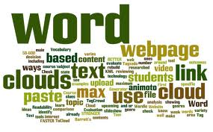
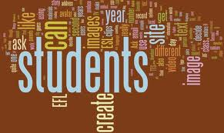
Word Clouds
And Beyond

Slide 2
About me:
25
12
13
12
Years teaching
Math and Science
SPED
Using technology
About you:
slocue.weebly.com
Complete brief survey
Word cloud

Slide 3
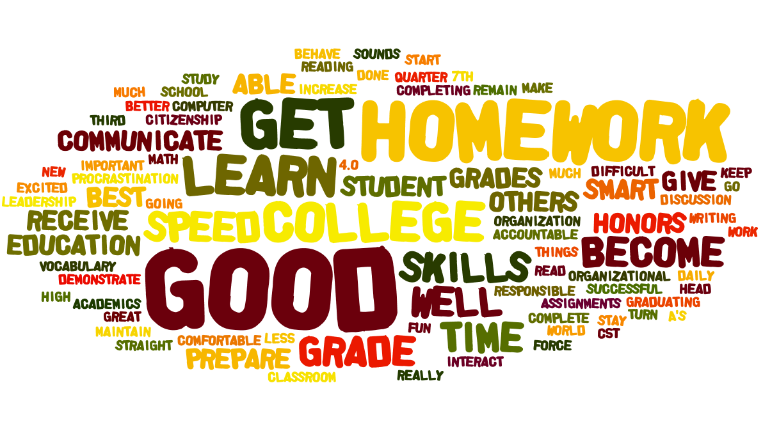
What are word clouds??
Digital tool used to convert text from various sources into a graphic image.
Size of the words is determined by the frequency of word use.
Parents’ goals for their children-Back To School Night

Slide 4
So, how do word clouds work??
1) You need text.
Student generated text from Google Forms
Passage from novel, textbook, online article, speech, etc.
Vocabulary words, synonyms, antonyms,
Parts of speech, phrases, transitional words.

Slide 5
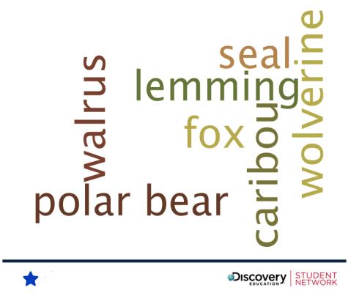
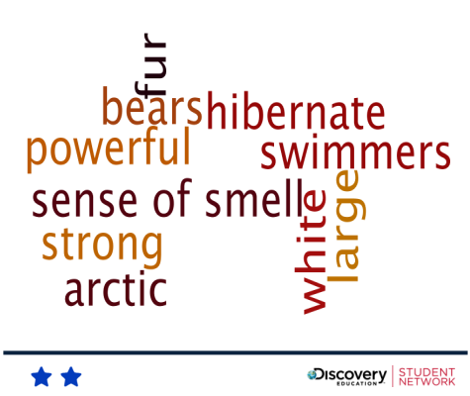
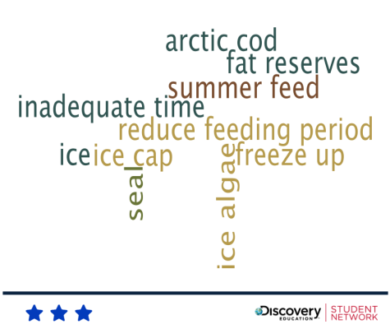
Student Generated Challenges. Guess the Wordle
http://projectsbyjen.com/GTW/
Common Core
Application
http://blog.discoveryeducation.com/dsn/2013/06/05/wordle-wednesday/

Slide 6
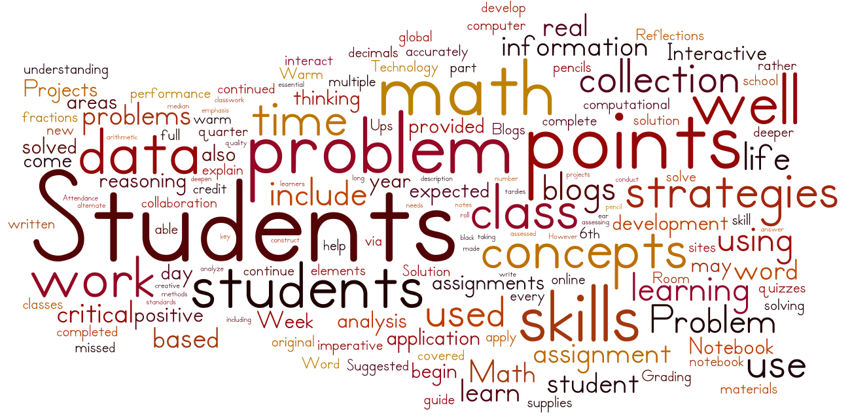
What are the benefits of using word clouds?
Get the gist of text
Word cloud of my math syllabus

Slide 7
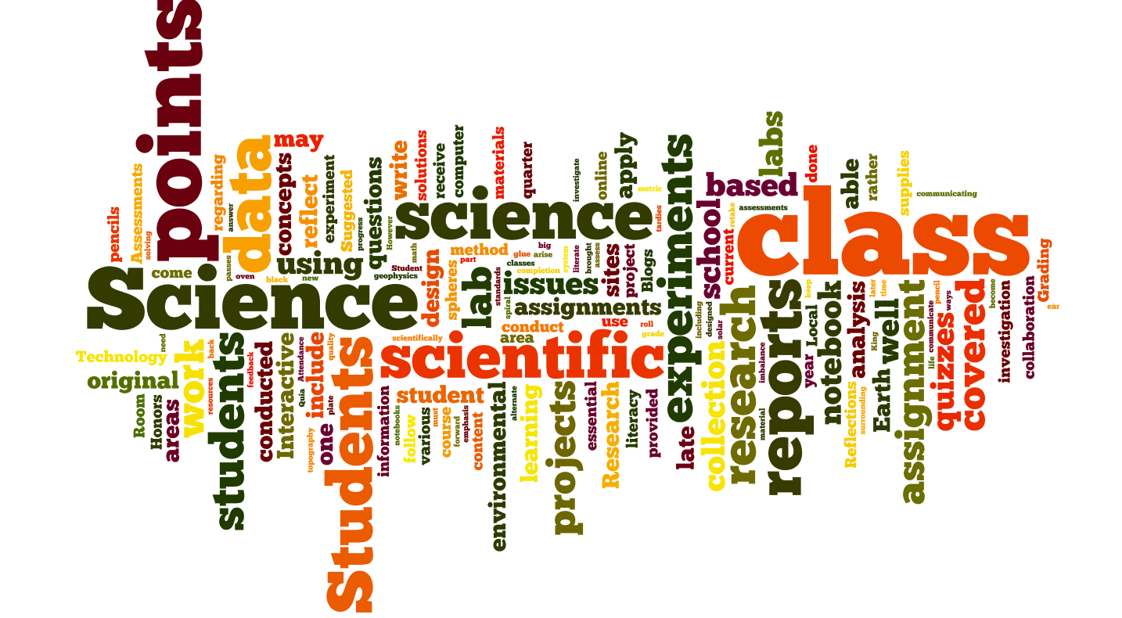
Word cloud of my Science syllabus

Slide 8
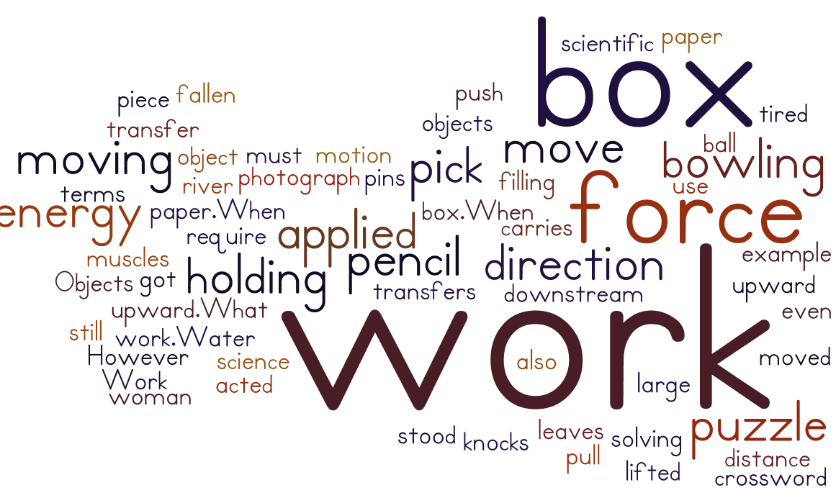
A Science text example:

Slide 9
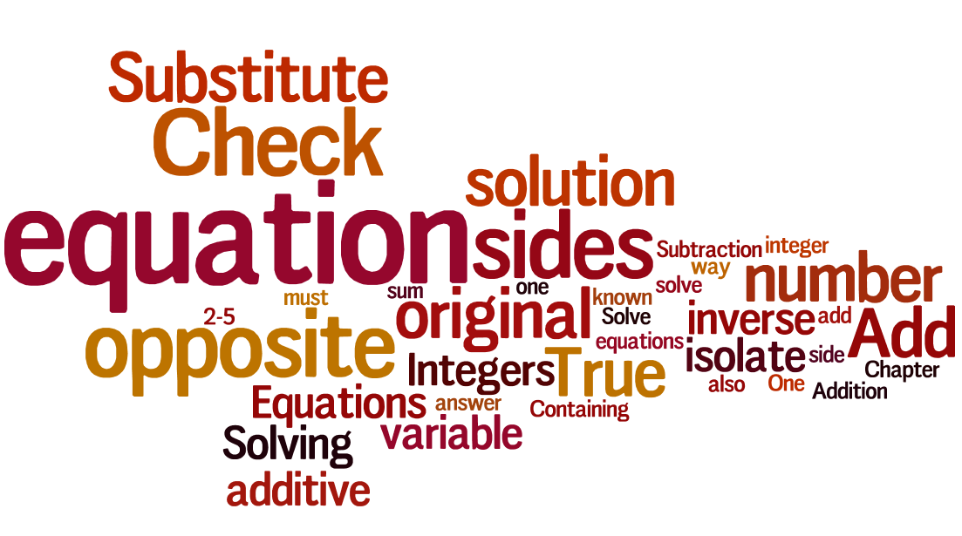
Text from a Math book.

Slide 10
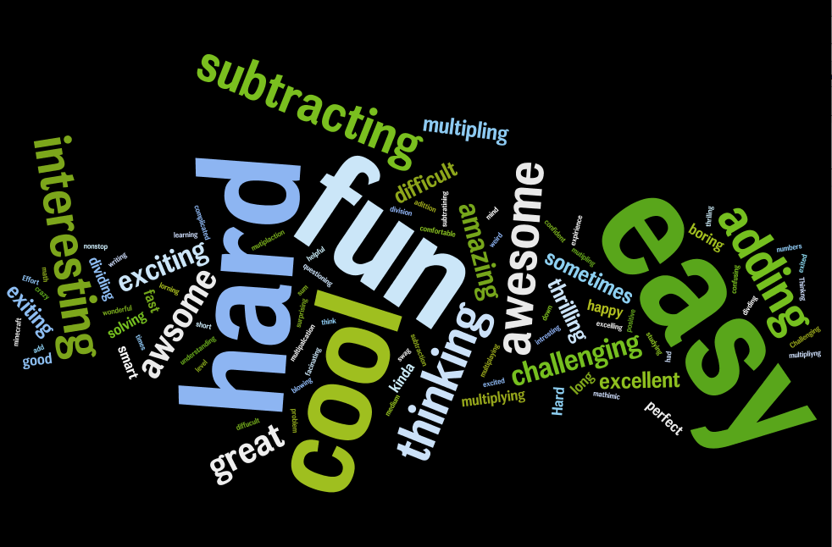
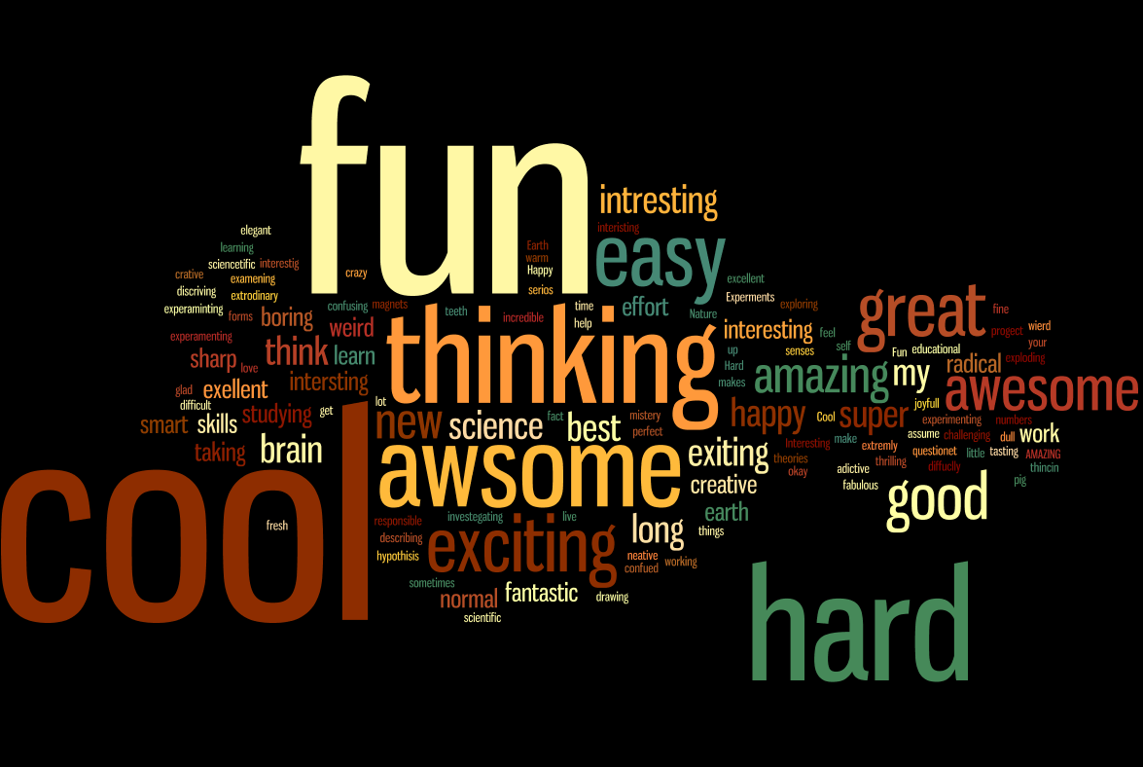
Uncover student attitudes toward subject
Math attitude word cloud
Science attitude word cloud

Slide 11
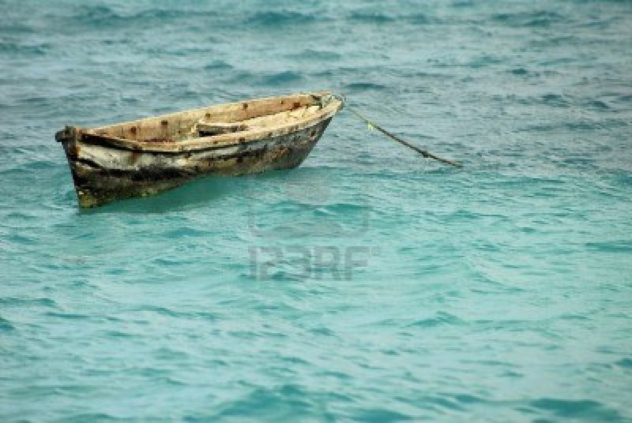
Catching the drift
Check to see if student writing is on topic, or if it has started to lose focus.
Seeing really is believing. Let the word cloud be the judge about possible drift in essay.
Copy and paste the essay into a word cloud. See if the most frequently used words are still on topic.

Slide 12
Let’s look at a matrix chart:
Word Cloud Matrix
Sample Science text.
Energy and Work
In science, is the use of force to move an object some distance.
A force is a push or a pull. In scientific terms, solving a crossword
puzzle does not require work. However, filling out the puzzle with a
pencil is work, because you are moving the pencil.
Work transfers energy. You do work on
objects when you move them. For example,
you do work when you pick up a piece of
paper.When you pick up the paper, you
transfer some of your energy to it. Objects
can also do work.Water in a river does
work as it carries fallen leaves downstream.
A bowling ball does work when it knocks
down bowling pins.
In the photograph, the woman is holding
a large box.When she lifted the box, she
did work on it. She applied a force that
acted in the same direction as the motion
of the box. The force was applied in an
upward direction, and the box moved
upward.What if she stood still while holding
the box? She would not be doing work on
the box, even if her muscles got tired. She
must be moving the box to do work on it.
check your

Slide 13
Additional Resources:
http://www.teachthought.com/literacy-2/19-interesting-ways-to-use-word-clouds-for-learning/
http://www.edudemic.com/9-word-cloud-generators-that-arent-wordle/
http://www.smashingapps.com/2011/12/15/nine-excellent-yet-free-online-word-cloud-generators.html
http://www.lextutor.ca/vp/eng/output.pl

